Slide 1

https://pokemondb.net/pokedex/lugia

Slide 2

https://sonicpokemon.fandom.com/wiki/Lugia

Slide 3

https://www.pngkit.com/bigpic/u2q8o0i1e6e6q8e6/

Slide 4

https://www.pngitem.com/middle/mbbihJ_lugia-png-transparent-png/

Slide 5


Slide 6

https://www.wallpapervortex.com/wallpaper-17791_pokemon_lugia.html#.XlQTsDeSnic

Slide 7

https://www.kindpng.com/imgv/hTTowR_lugia-transparent-pokemon-fire-red-pokemon-super-rumble/

Slide 8

https://www.pngitem.com/middle/mbbiim_lugia-png-transparent-png/

Slide 9

https://favpng.com/png_view/pokemon-go-pok%C3%A9mon-gold-and-silver-pok%C3%A9mon-heartgold-and-soulsilver-ash-ketchum-lugia-png/RwwE34E6

Slide 10

https://www.pngkit.com/view/u2q8o0i1e6r5w7t4_lugia-lugia-3d/

Slide 11
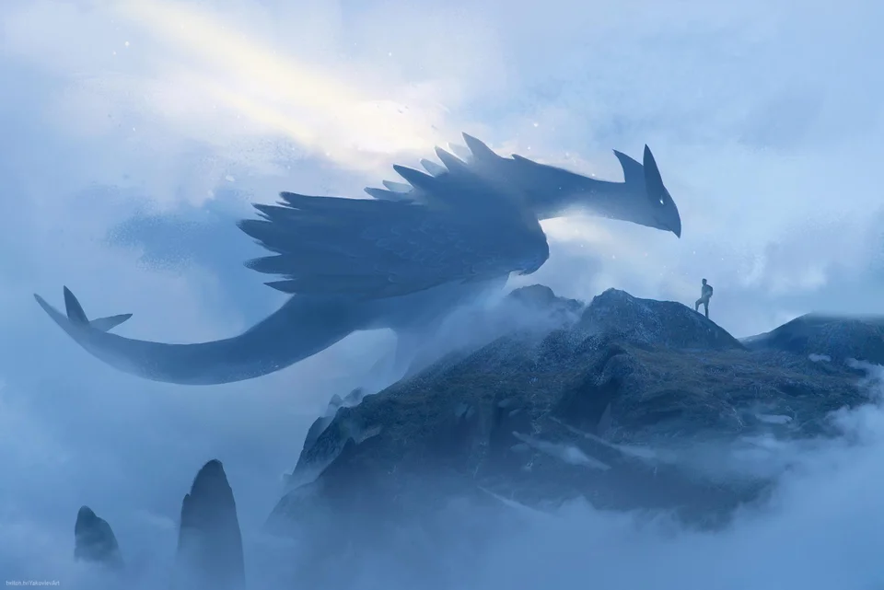
https://www.reddit.com/r/pokemongo/comments/8518dr/lugia_fanart_i_recently_did/

Slide 12
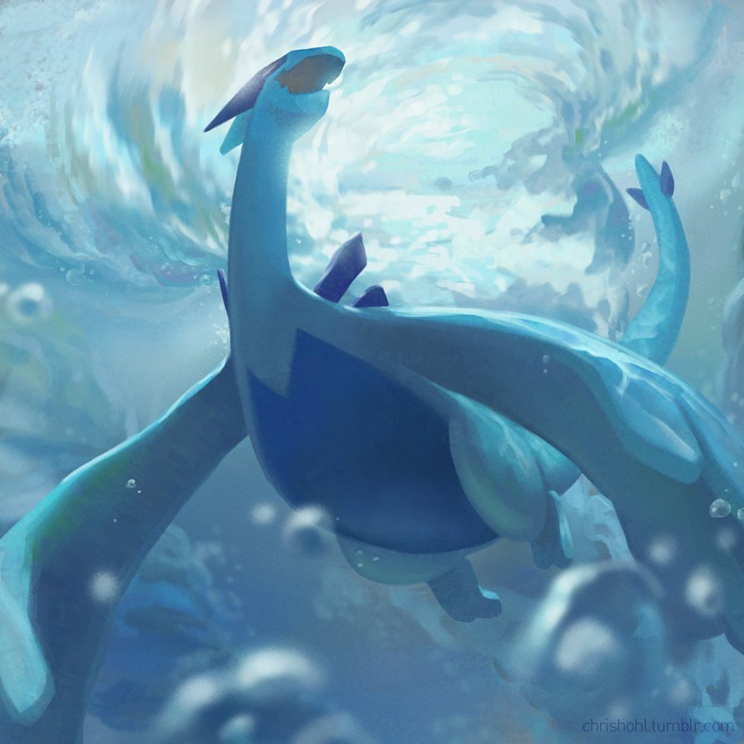
https://twitter.com/pokemonart/status/798196797625737216

Slide 13
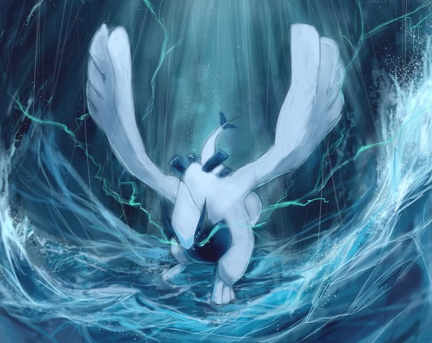
https://www.zerochan.net/1774343

Slide 14

https://www.pinterest.de/pin/5348093281668152/

Slide 15

https://weheartit.com/entry/329050099

Slide 16
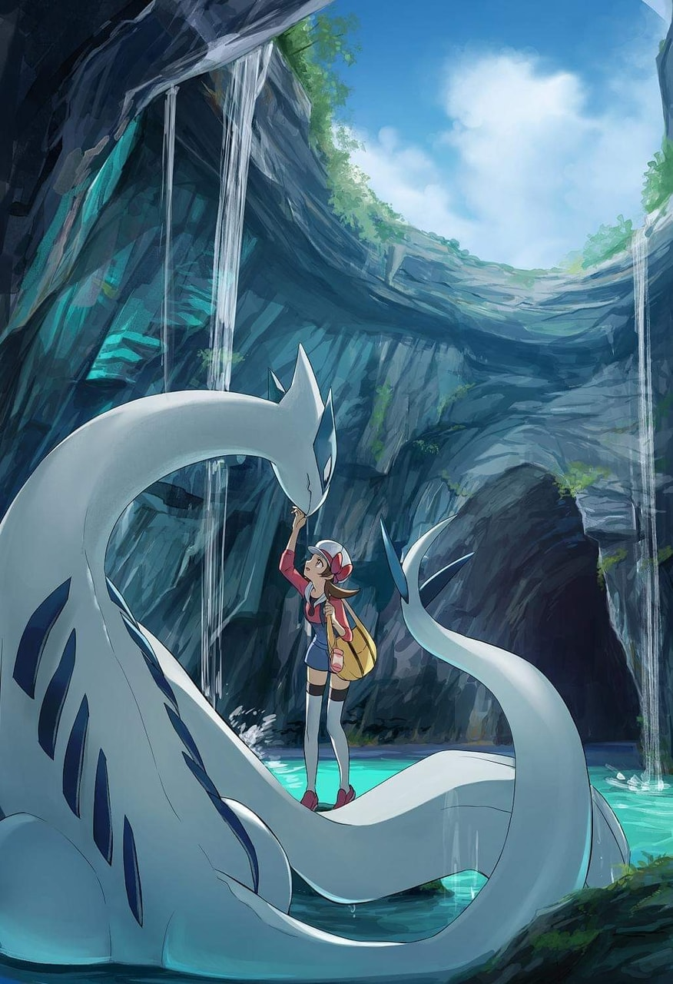
https://weheartit.com/entry/329050078

Slide 17
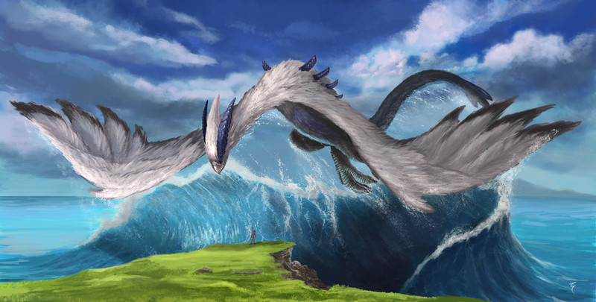
https://www.artstation.com/artwork/GJ2a3

Slide 18
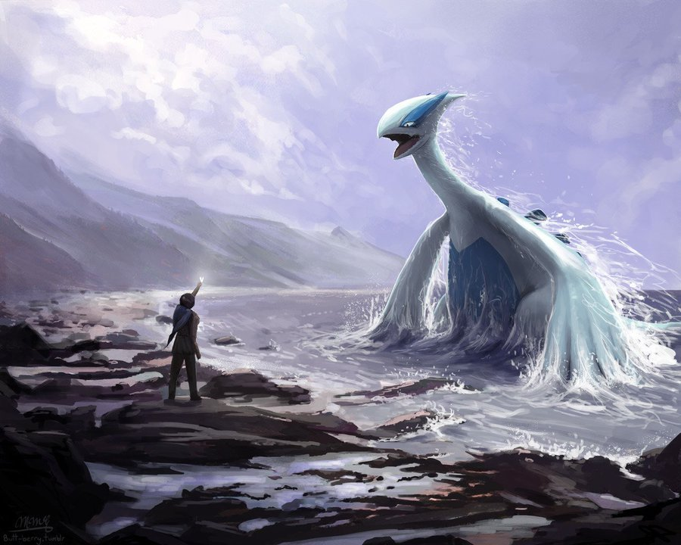
https://twitter.com/pokeimagen/status/900063847045791745

Slide 19
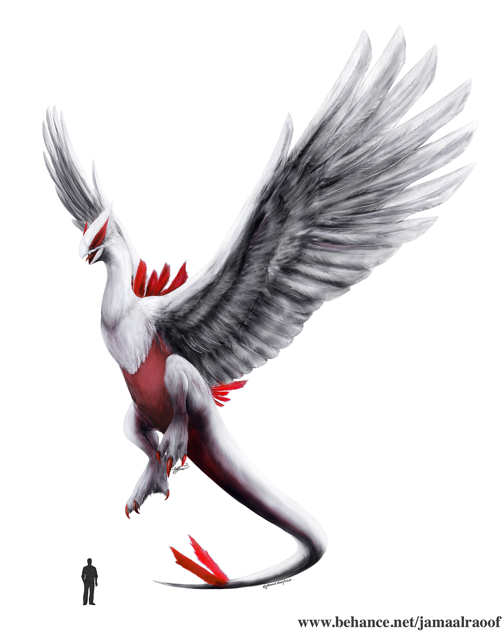
https://www.behance.net/gallery/62457979/Realistic-Lugia

Slide 20
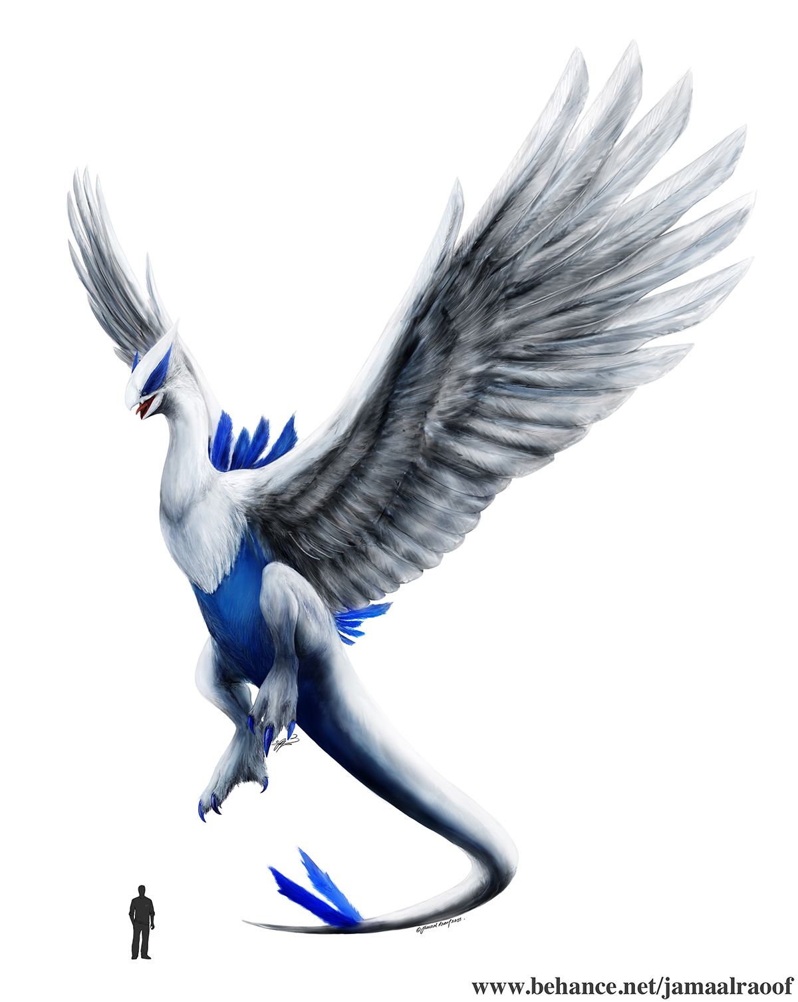
https://www.behance.net/gallery/62457979/Realistic-Lugia

Slide 21
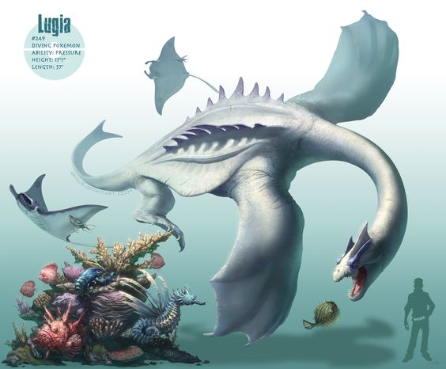
https://www.pinterest.se/pin/570338740282783401/

Slide 22

https://www.pokemonpets.com/Pokemon-Picture.aspx?Pokemon=Shiny-Shadow-Lugia

Slide 23

https://ya-webdesign.com/image/lugia-transparent-character-pokemon/1124074.html

Slide 24

https://www.kissclipart.com/lugia-clipart-pokmon-xd-gale-of-darkness-lugia-gam-z4zd3z/

Slide 25

https://pokemondb.net/artwork/lugia

Slide 26

https://hdwallsbox.com/lugia-pokemon-black-and-white-crystal-fire-wallpaper-137198/

Slide 27

https://www.wallpaperflare.com/pokemon-lugia-pokemon-wallpaper-mzesc

Slide 28

https://i.pinimg.com/originals/d5/ce/26/d5ce263955cb1a449d32f20697b3c569.jpg

Slide 29

http://getwallpapers.com/wallpaper/full/4/2/2/232518.jpg

Slide 30

http://getwallpapers.com/wallpaper/full/8/8/e/232555.jpg

Slide 31
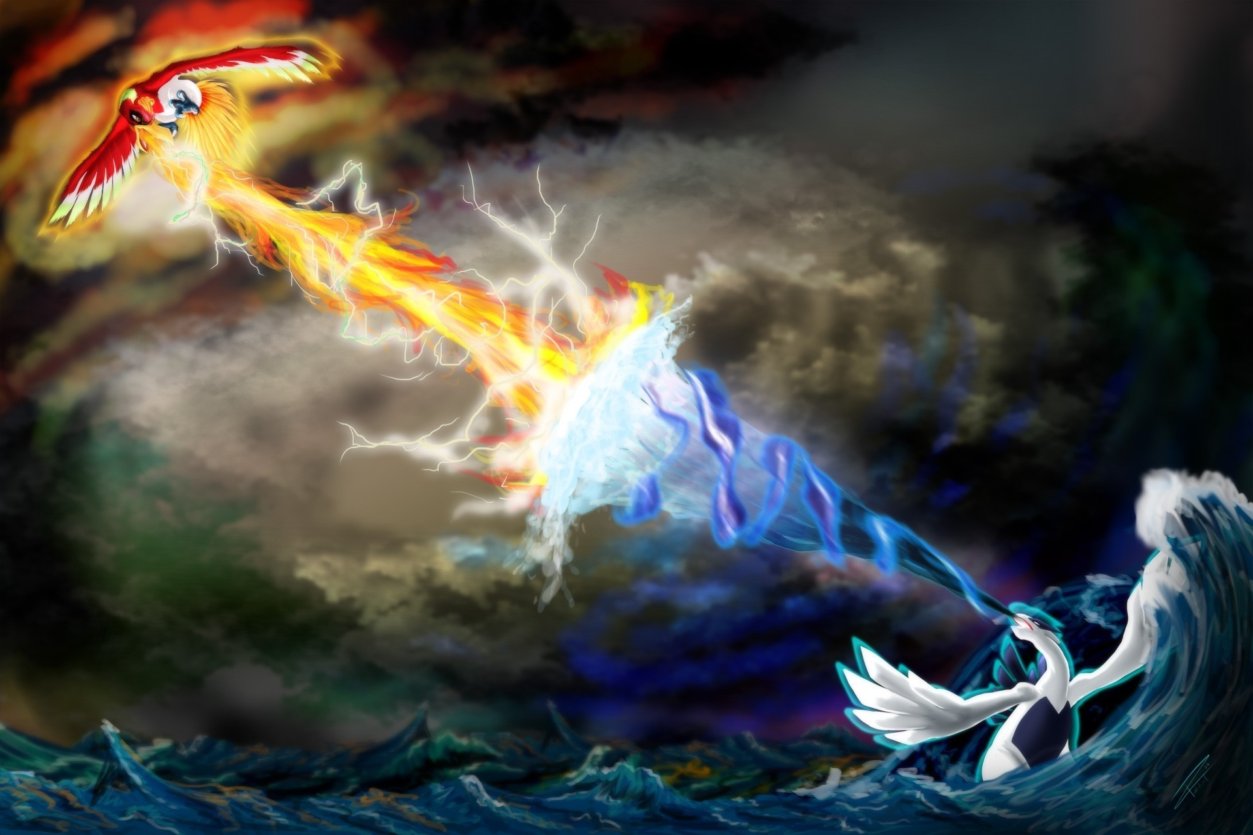
http://getwallpapers.com/wallpaper/full/7/4/c/232157.jpg

Slide 32
Lots more pics
https://art.alphacoders.com/by_tag/39185

